Slide 1
PacLang Project
Pacific Island Languages Project:
Reaching out to local communities – Building a Network of Pacific Island Language providers for community outreach products

Slide 2
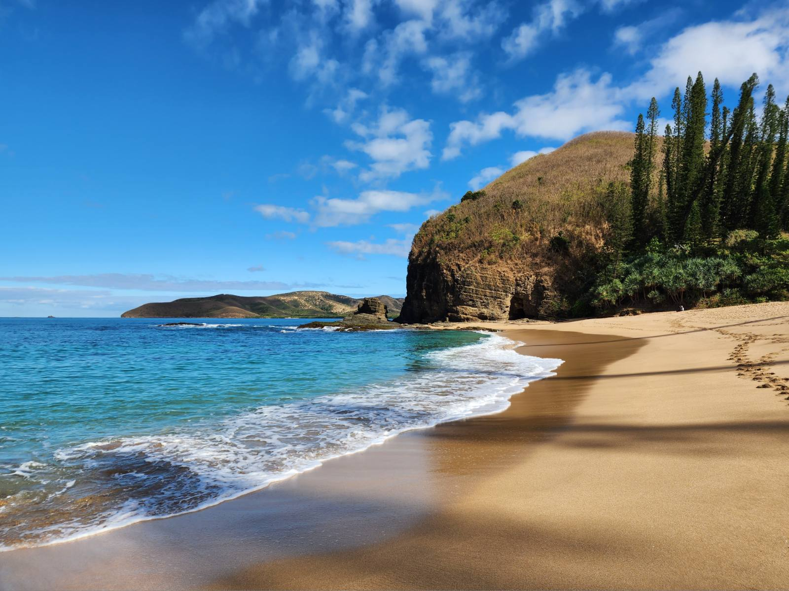
Warm Pacific Greetings!
Talofa lava
Welkam olgeta
Hafa adai
Iakwe
Talofa ni
Alii
Ran annim
Mālō e lelei
Kaselehi
Bonjour
Namaste
Talofa
Ia ora
Kia orana
Fakaalofa lahi atu
Mogethin
Ko na Mauri
‘Mo Yoran
Ni sa bula

Slide 3
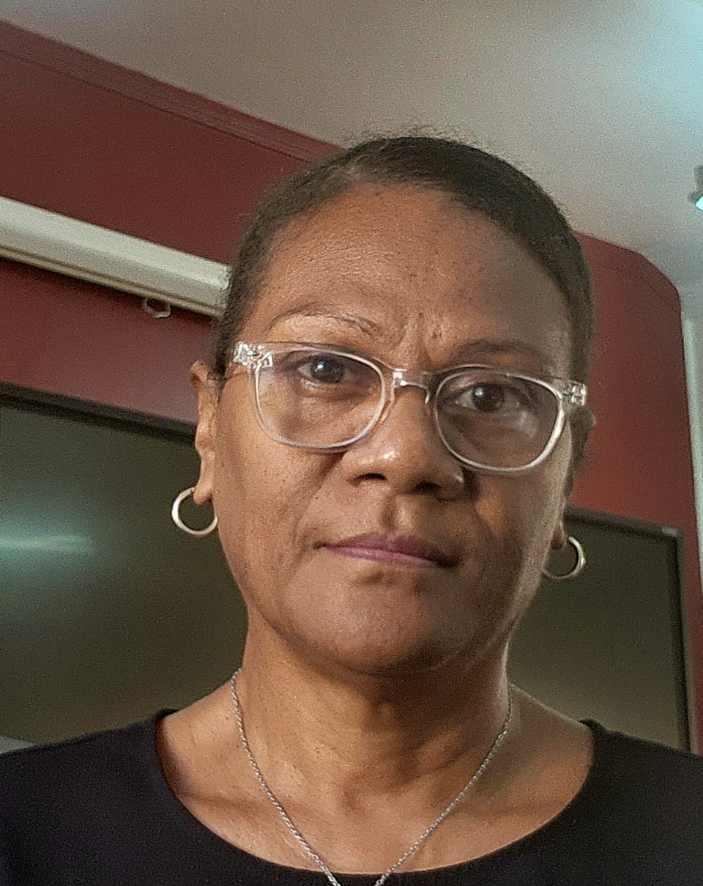
Introduction – Who are we?
Audrey Roiné Translation Coordinator SPC, Noumea | Jane Kanas Project Officer PacLang Project SPC, Noumea
Celine Muron Information and Outreach Officer FAME SPC, Noumea | Nicole Thai Procurement and Grants Officer OMD SPC, Noumea

Slide 4
Session topics
Brief background information on SPC
SPC’s work
How project started
What is the project about
What are the needs of SPC divisions?
How you become part of the project
The project
Procurement process
Question time

Slide 5
SPC establishment
South Pacific Commission (SPC, acronym still used despite name change) – Now, Pacific Community
Founded in 1947 after WW2 – Australia, France, Netherlands, New Zealand, United Kingdom, United States.
Purpose: “promote the economic and social welfare and advancement of the peoples in the region”

Slide 6
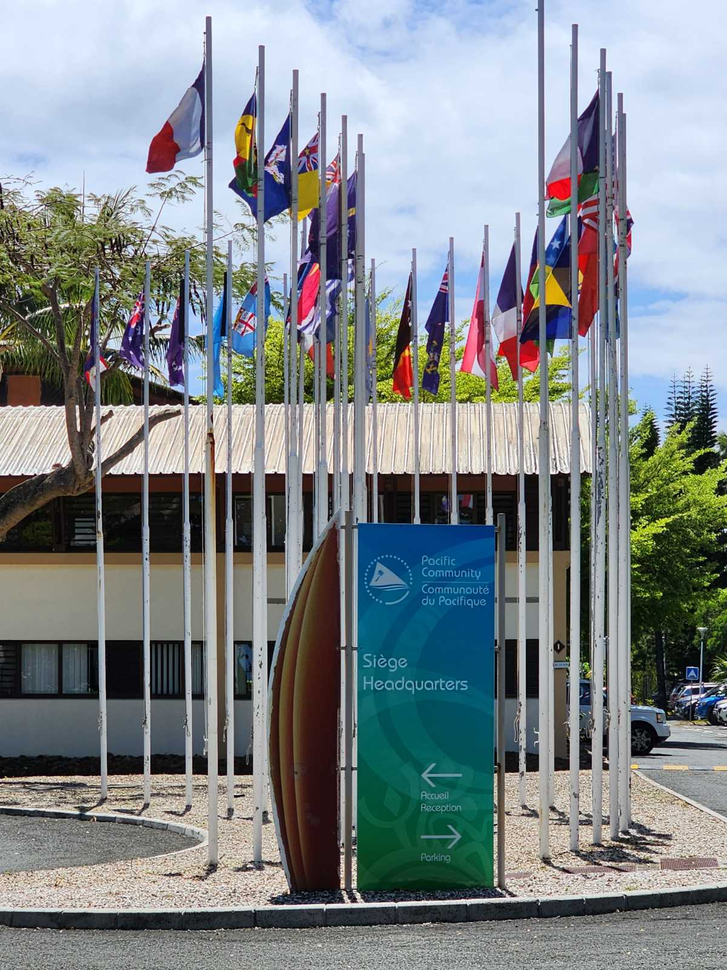
SPC today
27 member countries: 22 Pacific Island Countries and Territories + 5 founding/"metropolitan" members
New name: Pacific Community, 1997
Leading in technology and scientific activities through our divisions
Headquarters – Noumea
Campuses – Suva
Regional offices
Port Vila (Melanesia)
Pohnpei (Micronesia)
Nuku’alofa (Polynesia)
Paris (European)

Slide 7
SPC’s work

Slide 8
How the project was born
Tetum
Pingalapes
Luga
Pukapukan
Mwoakilloa
Mortlokese
Tolai
Te gana Tuvalu
Manihikan
Lea Faka Tonga
Enga
Gaga Tokelau
Drehu
Wala

Slide 9
Rationale
Need for divisions to create products in local languages for communities
No official list of service providers for vernacular languages
Identify and preselect such professionals to build a network of practitioners
Make available to divisions and other partners in the region (CROP agencies, etc.)
Source: SPC Strategic Plan 2022-2031

Slide 10
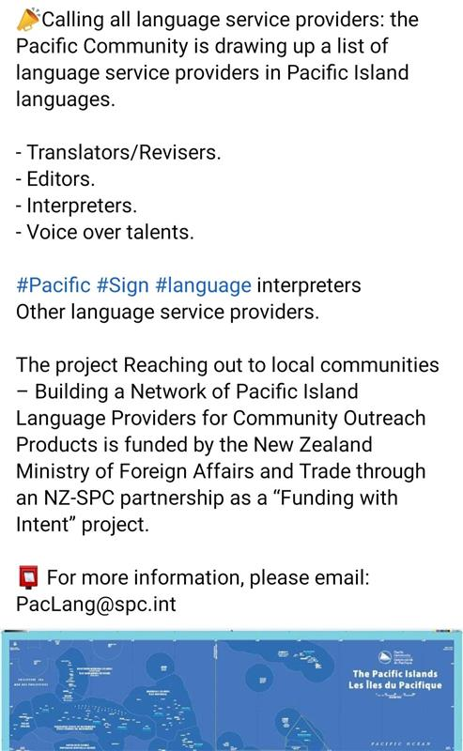
What is the project about?
A1. Recruit and train Pacific Island Language Service Officer
A 2. Identify the needs of SPC divisions and produce brief language country factsheets
A 3. Apply Procurement Process to source language providers
A.4 Develop communication materials and control mechanism for quality control
A.5. Draft a reflection report and develop a sustainability plan

Slide 11
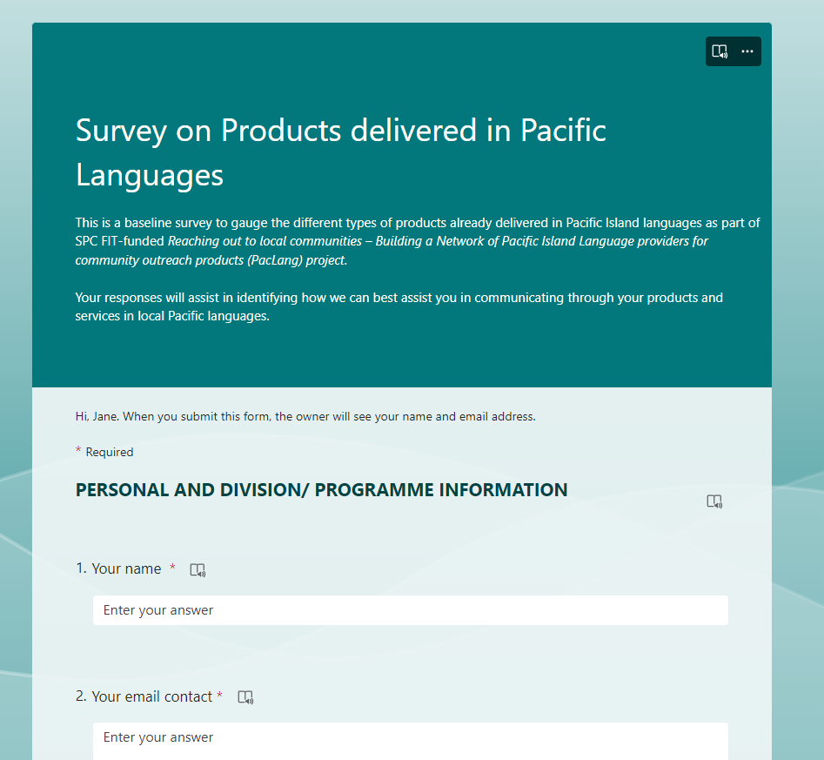
What are the Needs of the SPC Divisions?
Type of products
Written/spoken/voice-over
New products, translated products, audio
What languages?
In which countries?
Type of providers
Agencies
Freelancers

Slide 12
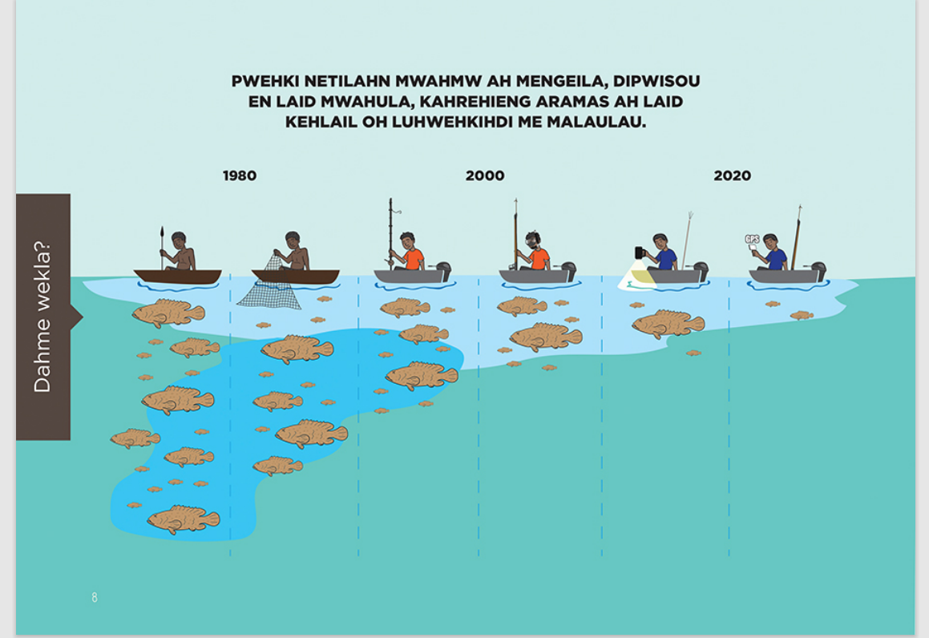
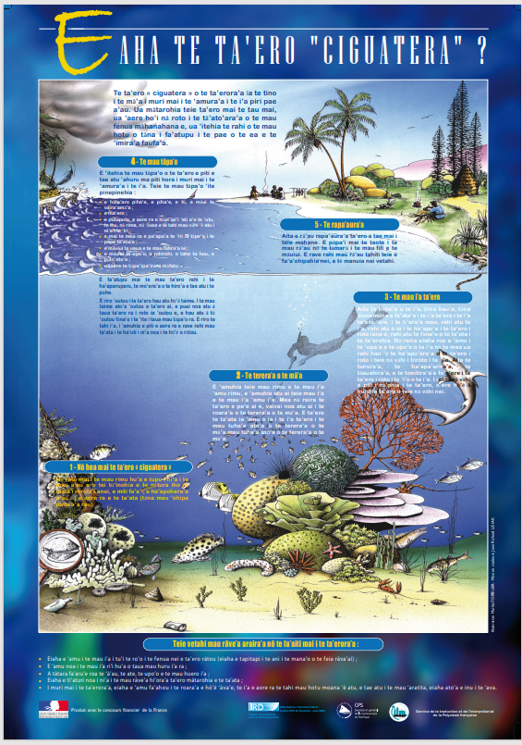
Samples of products – SPC Divisions
Sign language used
during Triennial
meeting during
COVID-19 by HRSD
Pohnpeian
Translation
Fijian
Tahitian
Bislama
Voiceover
Tuvaluan

Slide 13
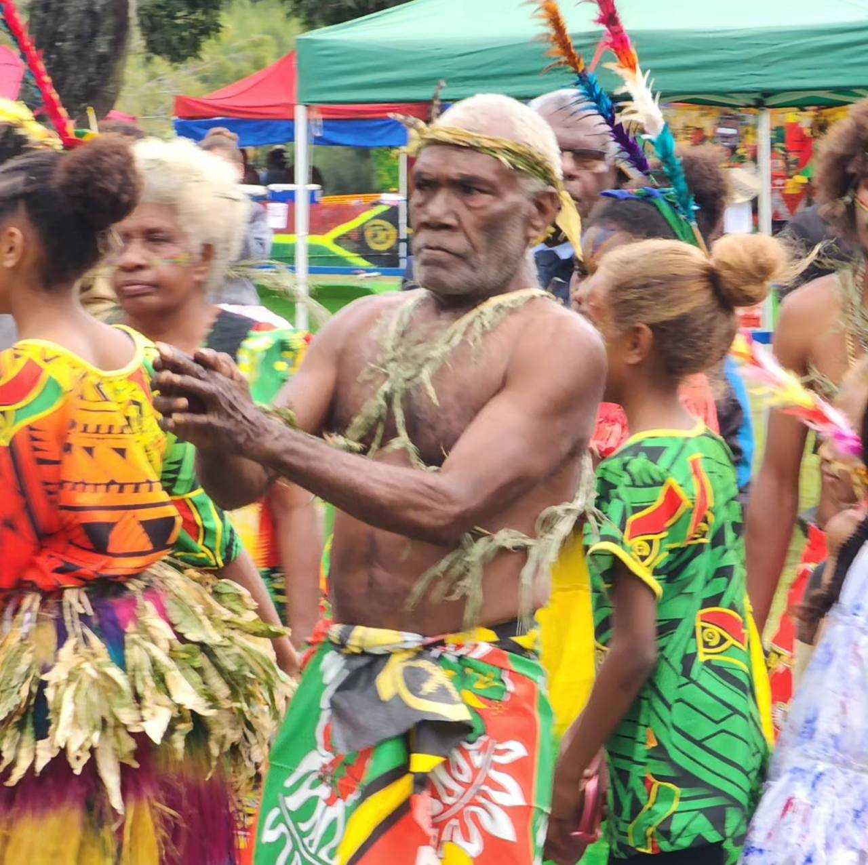
How do you benefit?
Your services are visible and accessible
Your marketability
Guardian of traditional language
Language sustainability and recognition

Slide 14
The Registry of Pacific Island Language Service Providers
List of contacts of Pacific language service providers
Language factsheets
Available online
Accessible to SPC divisions and other stakeholders
Pacific Island Country
Language
Language services
Contacts
Vital information

Slide 15
Procurement Process – RFQ and PSA
The Request for Quotation (RFQ) process is used for procurement valued at more than EUR 2,000 and less than or equal to EUR 45,000.
The purpose of this RFQ is to implement Preferred Supplier Agreements (PSA’s).
An example of a PSA is attached to the RFQ for your information.
PSA’s are established for an initial period of ONE (1) year and may be renewed for a period not exceeding THREE (3) years, depending on the results and the quality of the services provided.
In the event of a bid being accepted, procurement will take place under SPC’s General Terms and Conditions of Contract and the PSA conditions.
Any request to modify the General Contractual Conditions and/or the contractual clauses of the PSA must be made when the offer is submitted and attached to the submission.
In the absence of requests for amendments, the General Conditions of Contract and the PSA conditions will be deemed to be known, understood and accepted by the bidder.
Please contact SPC should you have any questions:
Jane KANAS, Pacific Island Language Service Officer (janek@spc.int);
The Procurement Team (procurement@spc.int).

Slide 16
Procurement – Submission
You must submit your quotation and all supporting documents in English or in French and as an attachment to an email sent to procurement@spc.int and with the subject line of your email as follows: Submission RFQ23-5876. The email should also be copied to rfq@spc.int.
The supporting documents expected in this RFQ are:
The Conflict-of-Interest Declaration form completed;
A resume written in either English or French;
The Technical Proposal Form from Annex 1 completed and signed;
The Financial Proposal Form from Annex 2 completed and signed;
The PSA template amended with your suggestions if needed (Annexe 4 of the PSA).
Bids will be evaluated on the basis of information received by 07/01/2024 at 23h00 (11 pm) New Caledonia time.

Slide 17
Procurement – Technical Evaluation Criteria
Evaluation criteria | Score Weight (%) | Points obtainable
Mandatory requirements
Conflict-of-Interest Declaration Resume Technical Proposal Form (Annex 1) Financial Proposal Form (Annex 2) | Mandatory requirements. Bidders will be disqualified if any of the requirements are not met
Technical requirements
Technical requirement 1: Experience in producing language products (translation and/or revision, interpretation, proofreading and/or editing, transcription, voiceover, sign language, etc.) one way or both ways between source and target language (Pacific language(s), English, French). | 40% | 280
Technical requirement 2: Good knowledge of the country (from which language is from) and the Pacific Region culture and values. | 20% | 140
Technical requirement 3: Good knowledge of areas relevant to SPC’s activities (fisheries, public health, climate change, etc.) and of development issues in the Pacific Islands region. | 15% | 105
Technical requirement 4: Tertiary or higher education, preferably in the area the candidate applies for, or equivalent professional experience | 15% | 105
Technical requirement 5: Demonstration of best practices in tools or systems used and quality control processes | 10% | 70
Total Score | 100% | 700

Slide 18
Do you have any questions?
Source

