Slide 1
Update on Regional REDD+ Project
Teresa Reubel, GIZ
30/09/2019, Apia
REDD+ Forest Conservation in Pacific Island Countries
Notes:
Honorable minister, colleagues, ladies and gentlemen
I am honored to speak in front of this audience.
My name is Teresa Reubel, I work for GIZ on the GIZ/SPC Regional REDD+ Project.

Slide 2
Presentation Structure
Part I
Part II
Brief overview of REDD+ II project
Brief overview of activities and achievements of REDD+ II project by countries
Brief overview of REDD+ II project extension period
Notes:
I have structured the presentation in two parts.

Slide 3
Brief overview of REDD+ II Project and its Activities and Achievements
Part I

Slide 4
Background Information
Duration:
4 years - 10/2015 - 08/2019 (12/2020)
Grant:
3,5 Million Euro from the Federal Ministry for the Environment, Nature Conservation and Nuclear Safety
Partner Organisation:
Pacific Community (SPC)
National & International Partners:
Respective Forest Departments of the countries
Live & Learn Environmental Education
Notes:
The project has been running for 4 years ending in August of this year. The project is in the process of receiving an extension from BMU until 12/2020. At the moment, GIZ is in prefinancing of this extension as the final confirmation is pending due to certain official protocols that need to be followed.
The previous grant was €3,5m; €1,5m will be added.
Our partner implementing organisation is SPC; we work in close collaboration with our partners in the respective countrie: the forest departments.

Slide 5
Main Objective
Melanesian island countries fulfill all requirements to participate in an UN-mechanism for climate change mitigation through improved forest management (REDD+)

Slide 6
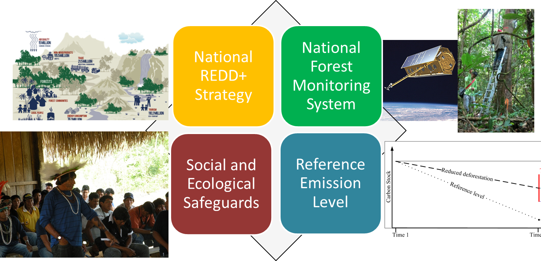
REDD+ Requirements
Notes:
REDD+ requirements under the UNFCCC

Slide 7
Planned Outputs
Regional level (Output I):
Regional REDD+ support structures are in place and functional
National level (Output II):
National REDD+ strategies are developed
Local level (Output III):
Practical experiences from demonstration activities and local scale forest carbon projects are integrated into national REDD+ strategies
Notes:
The project acts on three levels:
1) i.e. Development of methodologies for the detection and quantification of forest degradation, knowledge and data mgmt
2) i.e. Support REDD+ Units / REDD+ Steering Committees in the organization of national REDD+ strategies; Development of strategies for sustainable forest management and the restoration of degraded forest ecosystems
3) On the local level the project aims to feed back gained practical experiences from demonstration activities (on sustainable forest mgmt.) into the national REDD+ strategies

Slide 8
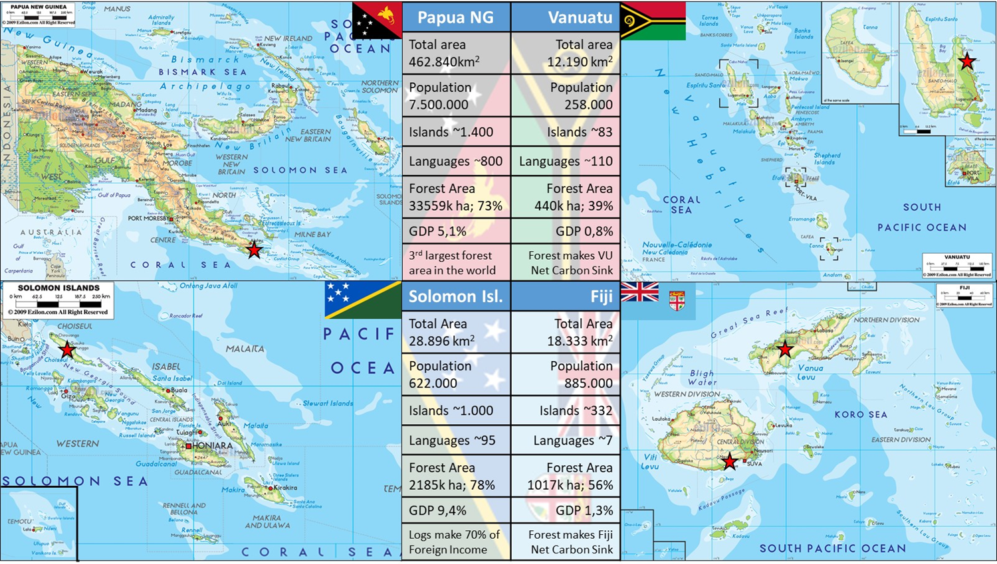
Pacific REDD+ Countries
Notes:
PNG has a special role as together with Costa Rica they proposed the RED mechanism in 2005. PNG is the biggest out of all four of them in terms of land area, population, islands, languages and forest area – it has the 3rd largest forest area in the world.
Solomon Islands is also quite diverse with over 1000 islands and large forest areas that the country continues to heavily rely on for logging (logs make up 70% of foreign income) - Mr Samuel Vazu will go into this in his presentation.
Vanuatu is the smallest out of the four, however with about 110 languages very diverse. Forests make Vanuatu a net carbon sink.
Fiji is bigger than Vanuatu and its land comprises of roughly 60% of forest which also makes Fiji and net carbon sink.
The project has demonstration pilot sites in all four countries. In Solomons, Vanuatu and Fiji the NGO Live and Learn is implementing the activities on forest conservation and alternative livelihoods, ie.through bee keeping. In Fiji and Vanuatu carbon has already been sold above market price.

Slide 9
Regional Level (Output I)
Regional REDD+ support structures are in place and functional, including:
Development of methodologies for the detection and quantification of forest degradation
Knowledge and data management
Development and administration of a regional registry for forest carbon projects

Slide 10
National Level (Output II)
National REDD+ strategies are developed, including:
Advise the development of standardized REDD+ process guidelines
Support REDD+ Focals / REDD+ Steering Committees in the organization of national REDD+ strategies
Development of strategies for sustainable forest management and the restoration of degraded forest ecosystems

Slide 11
Local Level (Output III)
Practical experiences from demonstration activities and local scale forest carbon projects are integrated into national REDD+ strategies:
Testing national REDD+ strategy elements in demonstration and local scale project activities
Implementation of activities tackling the drivers of deforestation and for the restoration of degraded forest ecosystems in demonstration areas
Development of local forest carbon projects for the voluntary market

Slide 12
National Workshops & Activities – Papua New Guinea
Support to PNGFA Milne Bay pilot site
Participation at PNG REDD+ Partners Meeting in Kavieng - 03/17
Review of national REDD+ Strategy - 03/17
Update of Operational Plan - 06/17 & 05/18
Exchange on REDD+ Communication and Awareness – 08/17
South-South exchange on Collect Earth with Fiji Forestry Department & FAO – 12/16

Slide 13
Achievements & Activities – Solomon Islands
Continuous support to Babatana, Choiseul REDD+ pilot project
Stock Taking on Stakeholder Communication Needs - 05/17
Facilitation of first National REDD+ Committee Meeting – 05/18
Support to FPIC Barora Fa’a, Isabel Province (09/18)
Continuous support for development of Forest Reference Level (in cooperation with FAO), submission to UNFCCC and technical assessment (2018/2019)
Coordination of NFI Piloting and Capacity Building Programme (NFI design, field work, data analysis) (06-08/19)
Technical support to development of a National REDD+ Pilot Site
Development of a GCF Proposal for REDD+ to support REDD+ Readiness

Slide 14
Achievements & Activities - Vanuatu
Continuous support to Loru REDD+ pilot project (first sale of Verified Emission Reductions 07/16)
Workshops on REDD+ Awareness (11/16) and Communication needs (including other sectors and stakeholders) (5/17)
Support to development of new Forestry Act (end 2018)
Support introducing new MALFFB/DoF buisness plan format & annual reporting
Support for NFI / MRV activities (with FCPF & UNIQUE Forestry, ongoing)
Support to implementation and staffing of new GIS lab for NFMS, Climate Change and GHG Reporting housed within Forestry Department
Support establishment of Forest Reference Level (ongoing)
Notes:
with high interest of VU Government for national upscaling as national REDD+ Transition Strategy for 2019

Slide 15
Achievements & Activities – Fiji
Continuous support to and participation in Fiji’s RSC (MRV WG; Education WG) in close collaboration with the FCPF Team
Review of SESA Study deliverables, Feedback & Grievance Redress Mechanism Study, Driver Study, NFMS deliverables
Continuous support to Nakavu SFM pilot site activities
Support to Drawa Forest Block REDD+ pilot project (first sale of Verified Emission Reductions 5/18)
Support to Mangrove Biomass Inventory (08 – 12/17)
Revision of Fiji Diameter Limit Tables (DLT) for amendment of Forest Policy
Development of DLT training course for foresters, loggers and communities based on Nakavu pilot site experiences
REDD+ Communication Workshop (12/17)
Support to Forest Reference Level development (draft 11/18)
Drone study on the assessment of Forest Degradation and the potential for monitoring of logging operations (since 03/19)
Participation in ERPD and R-Package process (since 10/18)
Development of a Reforestation Guideline (since 06/19)

Slide 16
Brief Overview of Project Extension
Part II

Slide 17
Reasons for Extension
to successfully and sustainably complete project activities, different measures are still required in each country
enables an integration of the forestry sector into the NDCs
→ 5 elements for the extension period

Slide 18
Element 1: Support for the implementation of the NFI and MRV systems including data preparation (Fiji, Solomon Islands, Vanuatu)
planning for National Forest Inventories is supported; data collection is expected to start in 2019
preparation, analysis and interpretation of the data, as well as the derivation of possible management and policy options, takes more time and requires further capacity building
Notes:
A comprehensive NFI and its correct interpretation is the basic prerequisite to enable forest ministries to make management decisions regarding the forest areas they manage
So this preparation, analysis…and the project wants to support this.

Slide 19
Element 2: Preparation of National REDD+ Strategies and REDD+ Implementation Plans (Fiji, Solomon Islands, Vanuatu)
countries are in preparatory phase of their REDD+ Strategies and further support is needed
In particular, Social and Environmental Safeguards and Benefit Sharing Mechanisms are more time-consuming than expected due to complex land ownership, land use and carbon rights
Comprehensive consideration of all aspects and the necessary creation of legal certainty is an integral part of the success of REDD+ efforts
→ This way acceptance of the population can be achieved
Notes:
Papua New Guinea has successfully developed its national REDD+ strategy.
Particularly, Safeguards and BSM are more time-consuming than expected due to the complexity of landownership and rights of land use and carbon
The other countries are still in the preparatory phase and need further support in elaborating various aspects of the strategies

Slide 20
Element 2: Preparation of National REDD+ Strategies and REDD+ Implementation Plans (Fiji, Solomon Islands, Vanuatu)
REDD+ implementation plans are necessary for the practical implementation of the REDD+ measures identified in the National Strategies
The inter-sectoral coordination processes are particularly protracted
Papua New Guinea is drawing up its implementation plan (RFIP)
→ share its experience with the other countries through a South-South exchange
Notes:
Here we see a considerable learning opportunity for Fiji, SI and Vanuatu

Slide 21
Element 3: Continuation of the national and local pilot projects (all countries)
Findings from the pilot projects are discussed in the National REDD+ Steering Committees and integrated into the decision-making processes
The successful forest carbon projects for the voluntary market function as lighthouse projects for the operational and financial feasibility of the REDD+ approach
Vanuatu and the Solomon Islands are calling for local projects to be extended to other areas
Notes:
The pilot measures supported by the project already provide very important information for the development of REDD+ strategies and related policy decisions (e.g. new forestry law in Fiji)
In addition, the successful forest carbon projects for the voluntary market function as lighthouse projects for the operational and financial feasibility of the REDD+ approach.
Vanuatu (as part of their national REDD+ Transition Strategy) and the Solomon Islands, for example, are calling for local projects to be extended to other areas, and the project is intended to provide further support.

Slide 22
Element 4: Support for access to REDD+ relevant climate financing (Solomon Islands)
As only country, Solomon Islands were not supported in its REDD+ measures by the FCPF
→ current status of the REDD+ preparations are delayed
Assistance in accessing adequate funding for REDD+ activities (e.g. through GCF), including the transition from conventional, destructive to sustainable forest management
Notes:
The Solomon Islands were the only project country not supported by the Forest Carbon Partnership Facility in its REDD+ measures (instead UN-REDD).
Accordingly, the current status of the REDD+ preparations (REDD Readiness) has been delayed.
At the same time, the Solomon Islands have the greatest mitigation potential from the forest sector. This also represents the largest source of income for the state.
Against this background, the project was requested to support access to adequate financing for REDD+ activities (e.g. through the Green Climate Fund), including the transition from conventional, destructive to sustainable forest management.
Logging Sustainability Policy, National Forest Policy and FRL support this development

Slide 23
Element 5: Integration of the forestry sector with quantitative targets into the NDCs (all countries)
The forestry sector is currently not included with quantitative targets in the NDCs
At the same time, the sector is mentioned by all countries to be important in the current NDCs, also with reference to the supported REDD+ activities
Aforementioned measures enable countries, in cooperation with the Regional Pacific NDC Hub, to integrate the forest sector with ambitious quantitative targets into revised NDCs
Notes:
In all countries, …
Aforementioned measures enable countries, with the support of the project and in cooperation with the Pacific NDC Hub, to bring the forest sector with ambitious targets into revised NDCs.
This anchors the REDD+ activities sustainably in the national policies and thus stabilizes the success of the project.

Slide 24
Thank you!

